Slide 1
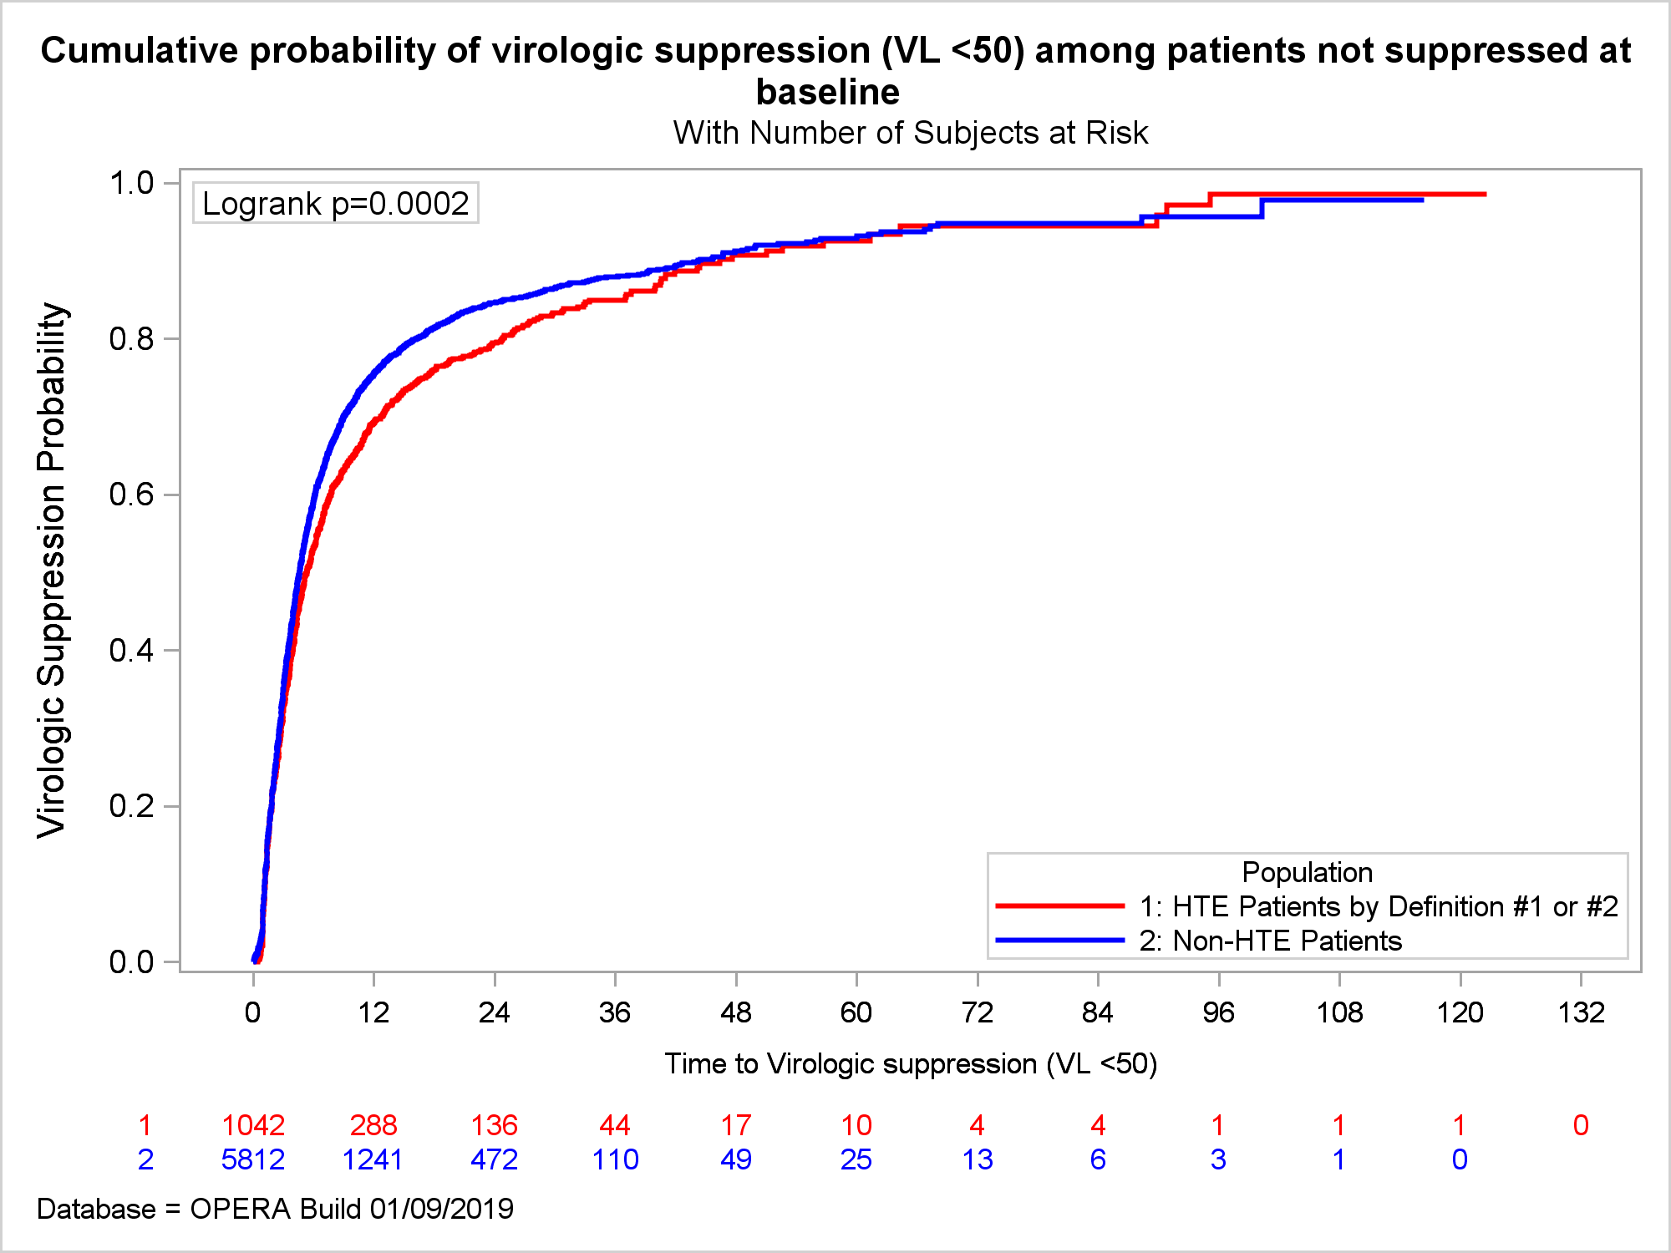
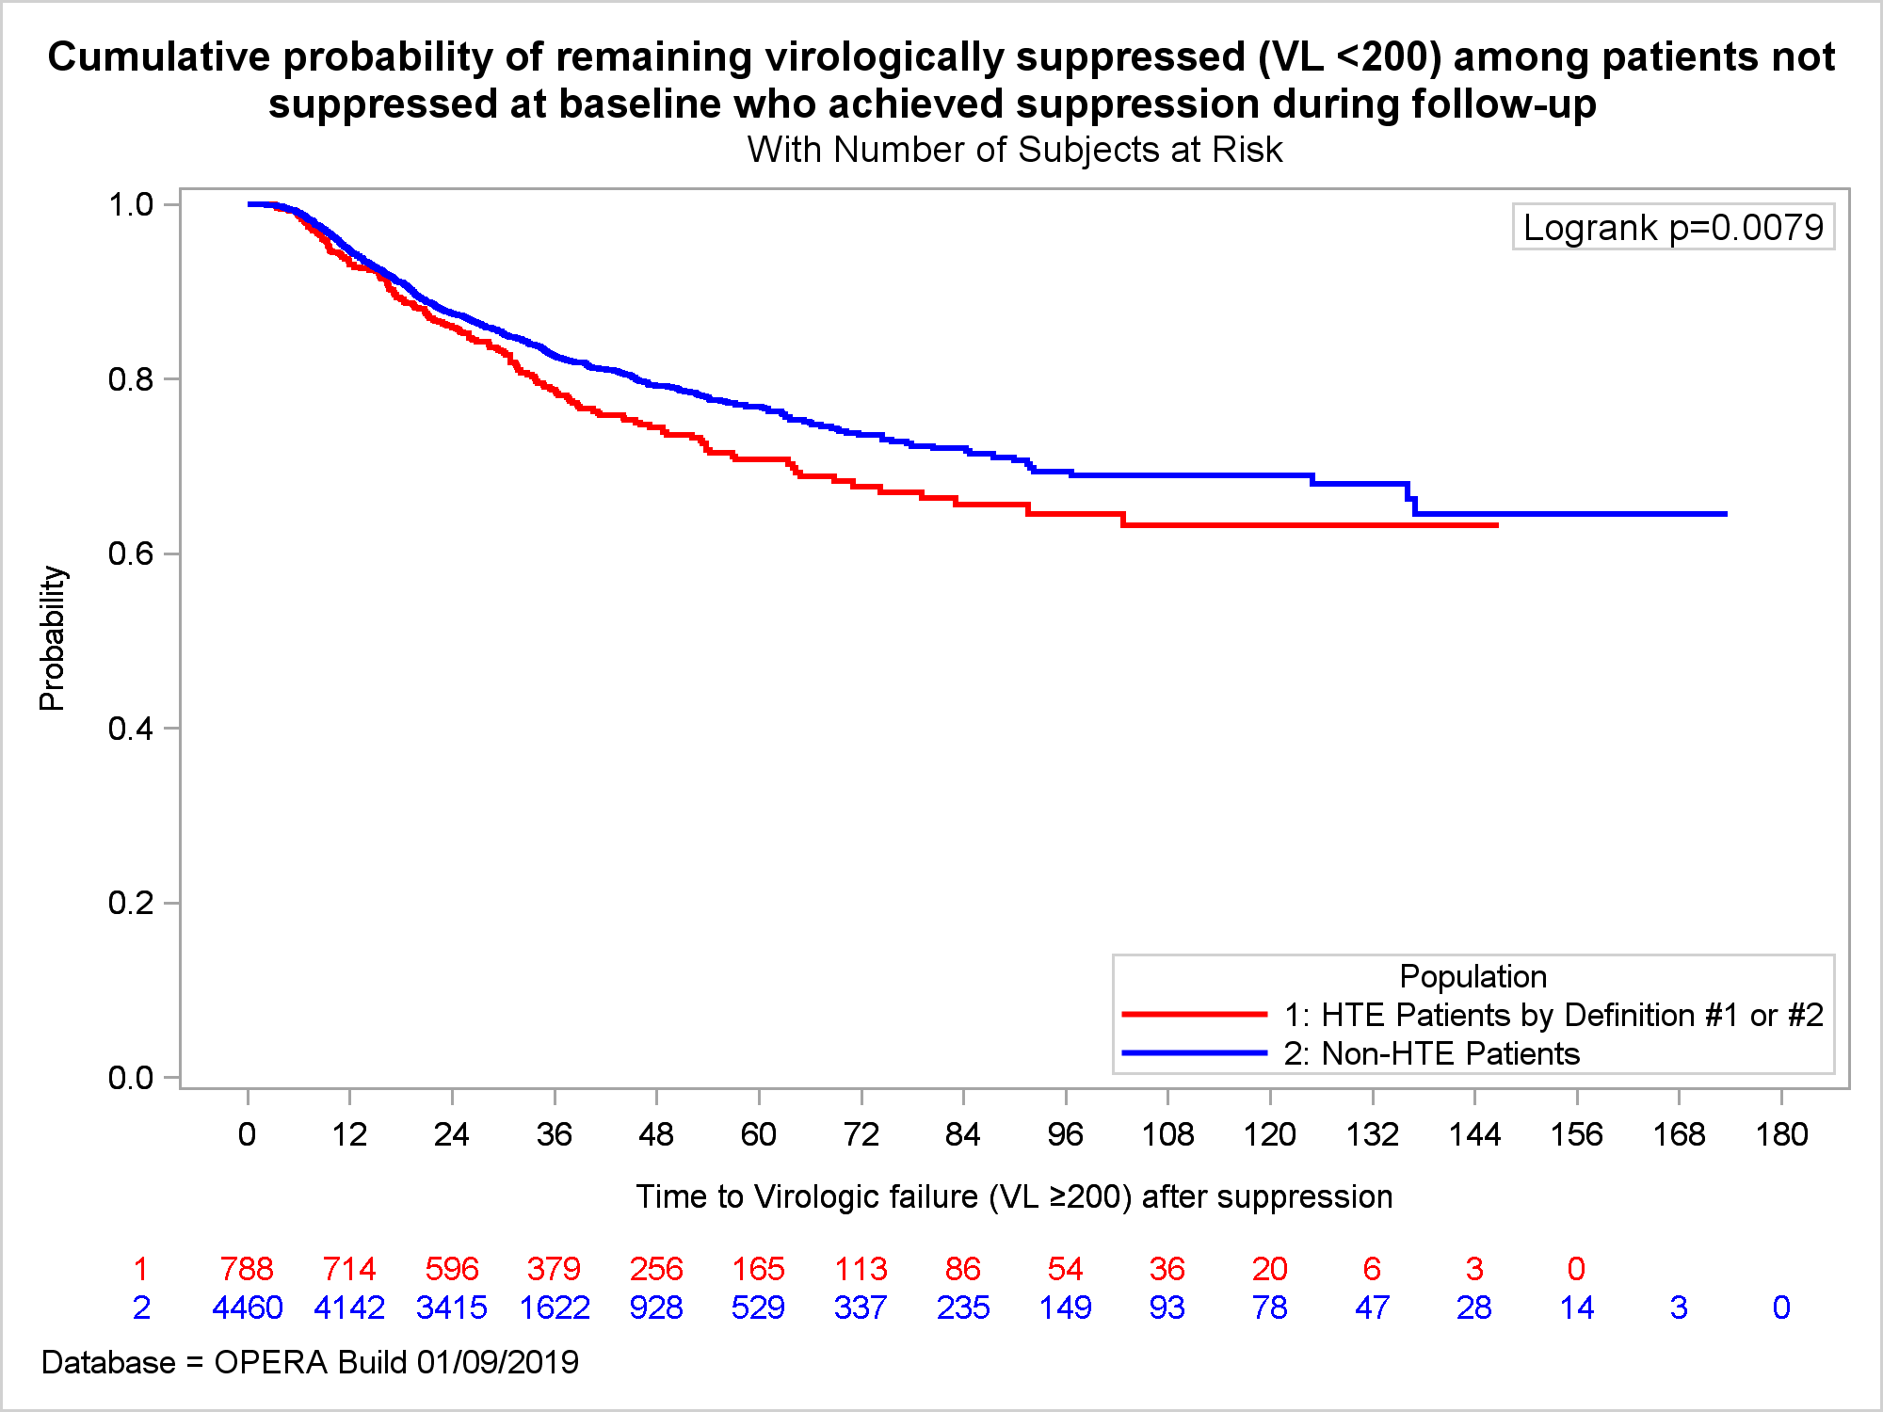
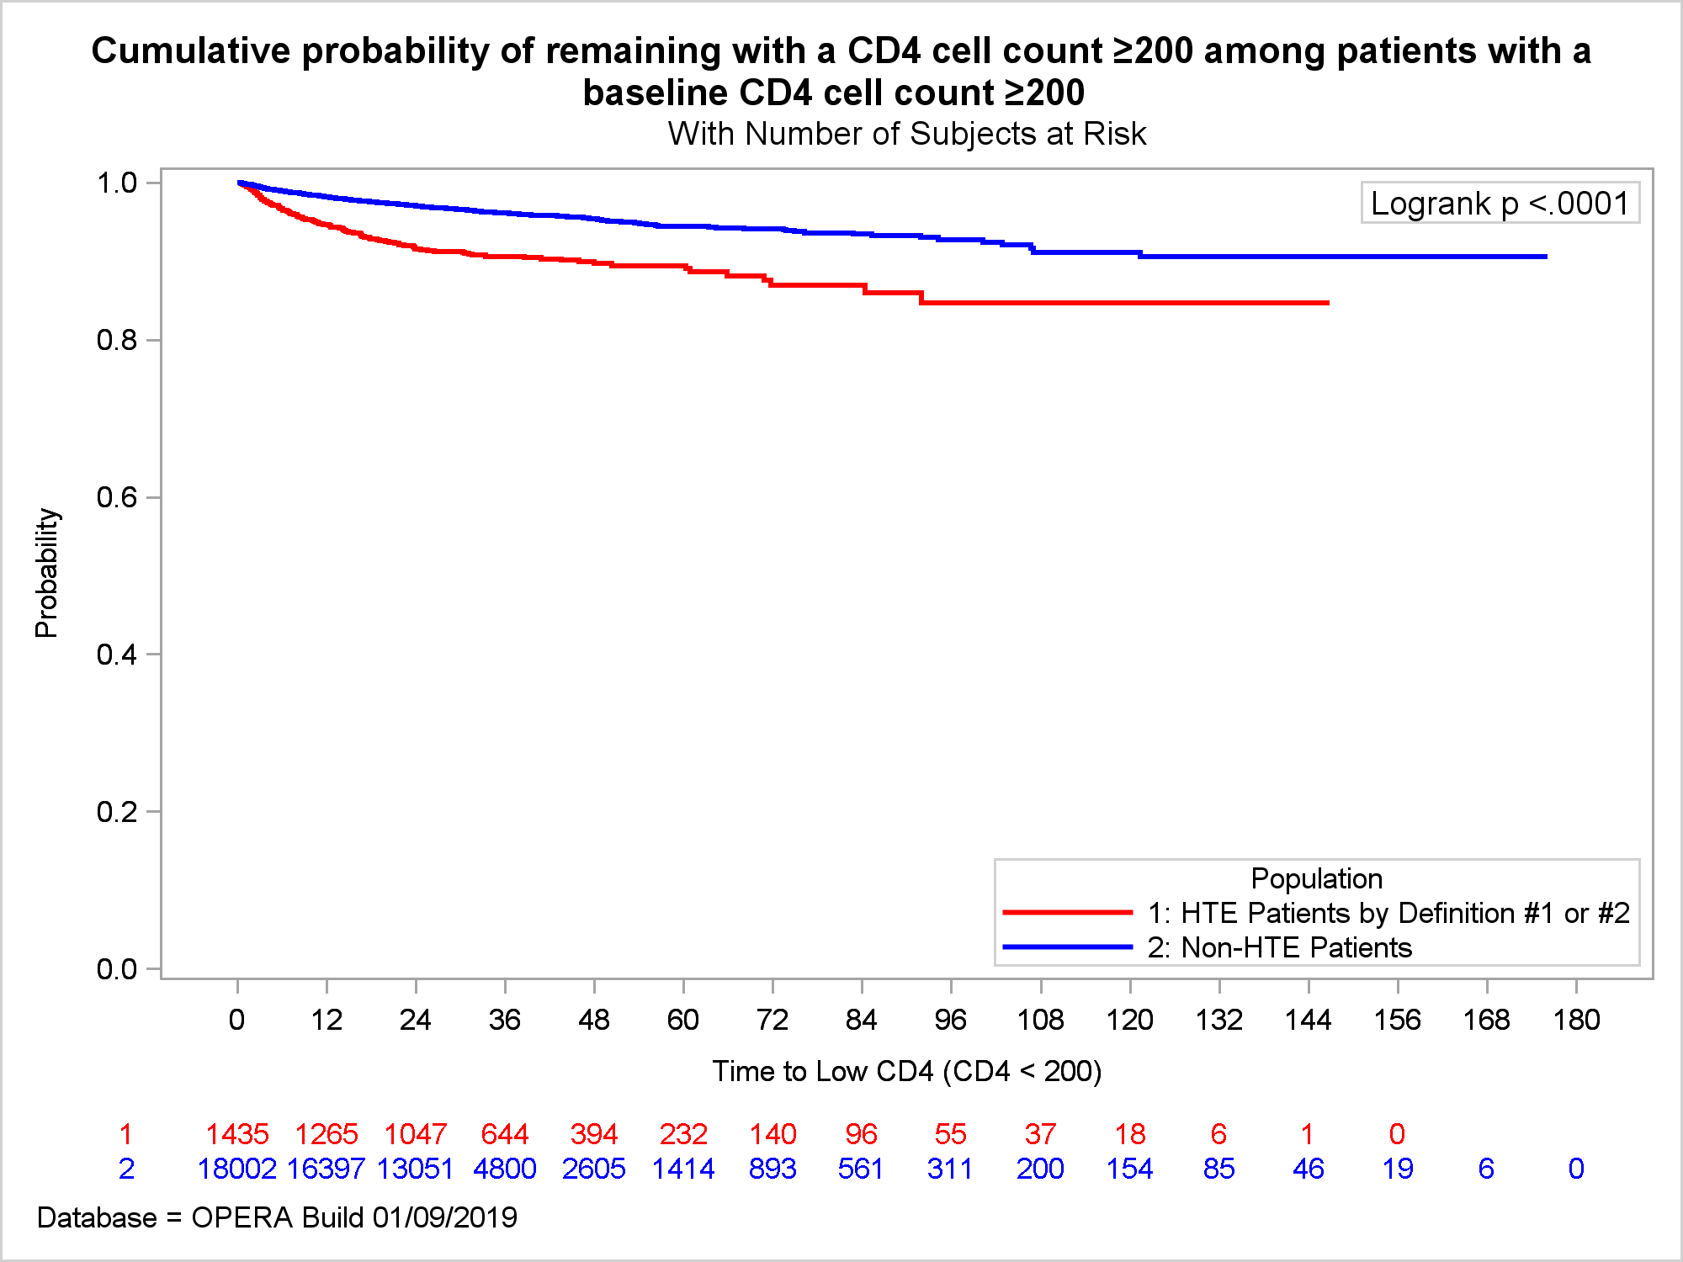
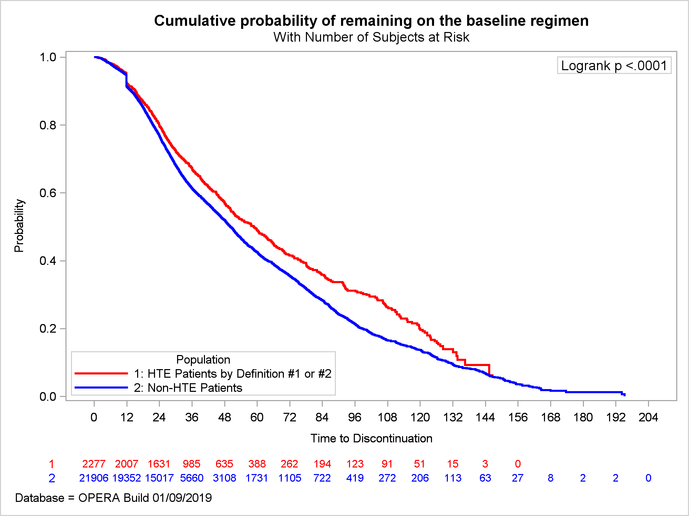
Poster
PEB0234
Clinical outcomes of heavily treatment experienced individuals in the OPERA Cohort
Ricky Hsu^{1,2}, Jennifer Fusco³, Cassidy Henegar⁴, Vani Vannappagari⁴, Cyril Llamoso⁵, Laurence Brunet³, Philip Lackey⁶, Gerald Pierone⁷, and Gregory Fusco³
¹NYU Langone Health Center, New York, NY; ²AIDS Healthcare Foundation, New York, NY; ³Epividian, Inc., Durham, NC; ⁴ViiV Healthcare, Research Triangle Park, NC;
⁵ViiV Healthcare, Branford, CT; ⁶Signature Healthcare, Charlotte, NC; ⁷Whole Family Health Center, Fort Pierce, FL
Author, Author and Author
Affiliation and address
Contact Information:
Jennifer S. Fusco
@: jennifer.fusco@epividian.com
Background
Results
Out of 1,527 HTE PLWH with follow-up VL (viremic: baseline VL ≥50 copies/mL: n=807, suppressed: <50 copies/mL: n=720): 238 (15.6%) had VL ≥200 copies/mL at 12 months
Out of 15,199 non-HTE PLWH with follow-up VL (viremic: baseline VL ≥50 copies/mL: n=4,297, suppressed: <50 copies/mL: n=10,902): 1,248 (8.2%) had VL ≥200 copies/mL at 12 months; p<0.0001
No single accepted definition of heavily treatment experienced (HTE)
Prevalence of HTE based on different definitions in the absence of resistance data were previously evaluated in OPERA ^{1,2}
Few studies have evaluated clinical outcomes of HTE in people living with HIV (PLWH)
Table 1. Baseline characteristics of HTE and non-HTE PLWH
 | HTE Population N=2,277 | Non-HTE Population N=21,906 | p-value^{c}
Age, median (IQR) | 50 (42, 56) | 44 (33, 52) | .<.0001
Female, n (%) | 431 (19%) | 3615 (17%) | .0.0068
Black Race, n (%) | 906 (40%) | 8612 (39%) | 0.0610
Hispanic Ethnicity, n (%) | 572 (25%) | 5626 (26%) | .0.2142
MSM, n (%) | 1190 (52%) | 12798 (58%) | <.0001
Years since HIV Diagnosis, median (IQR) | 15.3 (7.0, 21.8) | 7.1 (2.5, 14.5) | <.0001
Viral Load log¹⁰ copies/mL, median (IQR) | 2.0 (1.3, 4.2) | 1.3 (1.3, 2.0) | <.0001
CD4 Count cells/uL, median (IQR) | 412 (209, 636) | 587 (396, 801) | <.0001
AIDS defining events (ADE), n (%) | 1221 (54%) | 6294 (29%) | <.0001
Any comorbid condition,ª n (%) | 1823 (80%) | 15132 (69%) | <.0001
Any concomitant medications,^{b} n (%) | 1477 (65%) | 11071 (51%) | <.0001
Table 2. Clinical outcomes in HTE and non-HTE PLWH
Objective
To compare clinical outcomes among heavily treatment-experienced (HTE) people living with HIV (PLWH) and non-HTE, treatment-experienced PLWH in care in the United States.
 | HTE Population N=2,277 | Non-HTE Population N=21,906 | p-value
New ADEs | 108 (5%) | 506 (2%) | <.0001
New non-ADE comorbid conditions | 1,026 (45%) | 7,608 (35%) | <.0001
Deaths | 36 (2%) | 163 (1%) | <.0001
Methods
Discussion
Study population
ART-experienced HIV-1 positive, HIV-2 negative, ≥18 years of age, active in care, prescribed ART as of 31Dec2016
HTE:
Discontinued core agent from ≥ 3 classes of ART
or
Prescribed a regimen containing (a) dolutegravir (DTG) twice daily, (b) darunavir (DRV) twice daily, (c) etravirine (ETR), (d) integrase strand transfer inhibitor (INSTI) + protease inhibitor (PI), (e) maraviroc (MVC), or (f) enfuvirtide (ENF)
Non-HTE:
1 core agent + 2 NRTIs, not meeting the definition of HTE
ª Autoimmune disease, cardiovascular disease, invasive cancers, endocrine disorders, mental health disorders, liver diseases, bone disorders, peripheral neuropathy, renal disease, hypertension
^{b} DAA, antidepressants, NSAIDS, immune modulators, antibiotics, anxiolytics, hypnotics, sedatives, lipid lowering agents, anti-diabetics
^{c} Caution: Due to large sample size, clinically insignificant differences could be statistically significant for some baseline variables
The HTE population was older, with higher viral loads and lower CD4 counts at baseline than the non-HTE population; the HTE population had also been diagnosed with HIV a significantly longer time before baseline
While the non-HTE PLWH fared slightly better, HTE PLWH had 80% cumulative probability of suppressing to viral loads < 50 copies/mL and of maintaining their regimen at 24 months
The HTE population experienced a high burden of AIDS-defining conditions, concomitant medications, and comorbid conditions at baseline; they were also more likely to develop new comorbid conditions and die over follow up than the non-HTE population
Non-HTE PLWH were more likely to remain virologically suppressed and maintain their CD4 count above 200 cells/µL
Figure 2. Cumulative probability of virologic
suppression to VL < 50 copies/mL
(Among viremic PLWH at baseline)
Figure 3. Cumulative probability of remaining virologically
suppressed to VL < 200 copies/mL
(Among PLWH who achieved suppression)
Figure 1. HTE and Non-HTE Study Populations
Cumulative probability of virologic suppression
Cumulative probability of remaining suppressed
Key Findings
HTE PLWH were less likely to maintain their CD4 count above 200 cells/µL or to remain virologically stable, and at greater risk of death than non-HTE PLWH, suggesting additional therapeutic options are needed for this vulnerable population.
HTE (N=2,277)
Non-HTE (N=21,906)
 | Cumulative probability, % (95% CI)
 | 12-month | 24-month | 48-month
HTE | 69% (66, 72) | 80% (77, 82) | 91% (88, 94)
Non-HTE | 76% (75, 77) | 85% (84, 86) | 91% (90, 93)
 | Cumulative probability, % (95% CI)
 | 12-month | 24-month | 48-month
HTE | 93% (91, 95) | 86% (83, 88) | 75% (71, 78)
Non-HTE | 95% (94, 95) | 88% (87, 89) | 79% (78, 81)
≥ 3 core agent classes
only (n=707)
Regimen indicative of HTE only (n=1,497)
Months to viral load <50
Months with viral load <200
HTE
HTE
Both
(n=73)
Non-HTE
Non-HTE
Figure 4. Cumulative probability of maintaining CD4 cell
count ≥200 cells/µL
(Among PLWH with baseline CD4 ≥200)
Figure 5. Cumulative probability of remaining on the
regimen of interest
(Among all PLWH)
References
Outcomes
Virologic suppression: Among viremic PLWH, achieve a VL < 50 copies/mL
Virologic failure: Among PLWH who suppress, failure to maintain VL < 200 copies/mL
Immunologic preservation: Among PLWH with CD4 count ≥200 cells/µL, maintenance of CD4 count ≥200 cells/µL
Regimen discontinuation: Any change to the core agents of the regimen
Morbidity & mortality: A new AIDS defining illness or death
 | Cumulative probability, % (95% CI)
 | 12-month | 24-month | 48-month
HTE | 93% (91, 94) | 80% (78, 82) | 57% (55, 60)
Non-HTE | 91% (91, 92) | 77% (76, 78) | 52% (51, 53)
Henegar C, Fusco J, Vannappagari V, FuscoG. Evaluation of the Prevalence, Treatment, and Demographic Characteristics of the Heavily Treatment-Experienced (HTE) HIV-Positive Patient Population in the OPERA® Cohort Study Report. January 15, 2018 (updated April 5, 2018).
Hsu R, Henegar C, Fusco J, Vannappagari V, Llamoso C, Lackey P, Pierone G, Fusco G. Identifying heavily treatment experienced patients in the OPERA cohort. 22nd International AIDS Conference (AIDS). Abstract A-899-0141-05163. Amsterdam, Netherlands; July 23-27, 2018.
Cumulative probability of maintaining CD4 ≥200
Cumulative probability of maintaining regimen
Acknowledgements
 | Cumulative probability, % (95% CI)
 | 12-month | 24-month | 48-month
HTE | 95% (93, 96) | 92% (90, 93) | 90% (88, 91)
Non-HTE | 98% (98, 98) | 97% (97, 97) | 95% (95, 96)
This research would not be possible without the generosity of people living with HIV and their OPERA caregivers. Additionally, we are grateful for the following individuals: Robin Beckerman (SAS programming), Jeff Briney (QA), Bernie Stooks (Database Mgmt), Judy Johnson (Med Terminology Classification), Rodney Mood (Site Support)
Statistical analyses
Baseline pairwise comparison: Pearson Chi-Square test (categorical variables), Fisher’s exact test (few events), Wilcoxon Rank Sum test (continuous variables)
Time to event, comparison of survival distributions: Kaplan-Meier, log-rank tests
Support
This research was sponsored by ViiV Healthcare
HTE
Months with CD4 ≥200
HTE
Months on regimen
Non-HTE
Non-HTE
* HTE = heavily treatment experienced; MSM = men who have sex with men; VL = viral load
PRESENTED AT THE 23RD INTERNATIONAL AIDS CONFERENCE (AIDS 2020) | 6-10 JULY 2020

